Slide 1
Week-1 Operating System Overview
Operating Systems: Internals and Design Principles

Slide 2
Operating System
Exploits the hardware resources of one or more processors
Provides a set of services to system users
Manages secondary memory and I/O devices

Slide 3
Basic Elements
Processor
Main Memory
I/O Modules
System Bus

Slide 4
Processor
Controls the operation of the computer
Performs the data processing functions
Referred to as the Central Processing Unit (CPU)

Slide 5
Main Memory
Volatile
Contents of the memory is lost when the computer is shut down
Referred to as real memory or primary memory

Slide 6
I/O Modules
Moves data between the computer and external environments such as:
storage (e.g. hard drive)
communications equipment
terminals

Slide 7
System Bus
Provides for communication among processors, main memory, and I/O modules

Slide 9
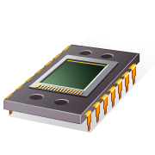
Microprocessor
Invention that brought about desktop and handheld computing
Processor on a single chip
Fastest general purpose processor
Multiprocessors
Each chip (socket) contains multiple processors (cores)

Slide 10
Graphical Processing Units (GPU’s)
Provide efficient computation on arrays of data using Single-Instruction Multiple Data (SIMD) techniques
Used for general numerical processing
Physics simulations for games
Computations on large spreadsheets

Slide 11
Digital Signal Processors (DSPs)
Deal with streaming signals such as audio or video
Used to be embedded in devices like modems
Encoding/decoding speech and video (codecs)
Support for encryption and security

Slide 12
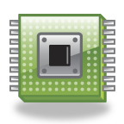
System on a Chip (SoC)
To satisfy the requirements of handheld devices, the microprocessor is giving way to the SoC
Components such as DSPs, GPUs, codecs and main memory, in addition to the CPUs and caches, are on the same chip

Slide 13
Instruction Execution
A program consists of a set of instructions stored in memory
processor reads (fetches) instructions from memory
processor executes each instruction
Two steps

Slide 15
Instruction Fetch and Execute
The processor fetches the instruction from memory
Program counter (PC) holds address of the instruction to be fetched next
PC is incremented after each fetch

Slide 16


Instruction Register (IR)
Fetched instruction is loaded into Instruction Register (IR)
Processor interprets the instruction and performs required action:
Processor-memory
Processor-I/O
Data processing
Control

Slide 17
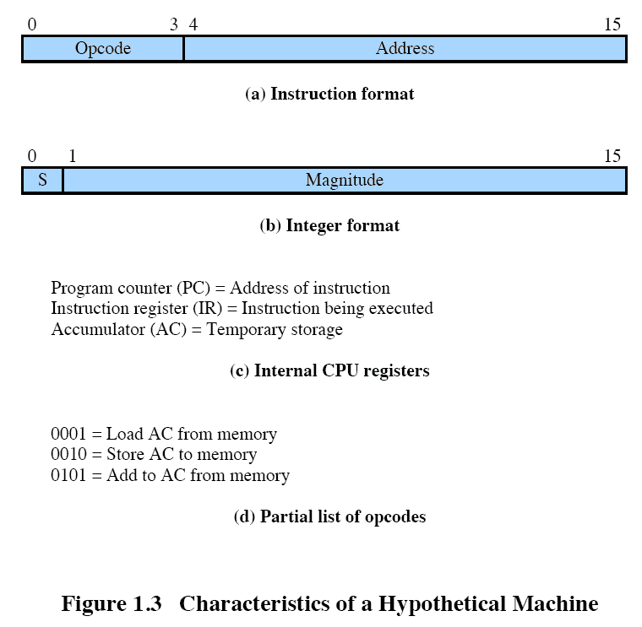

Slide 18
Notes:
x

Slide 19
Interrupts
Interrupt the normal sequencing of the processor
Provided to improve processor utilization
most I/O devices are slower than the processor
processor must pause to wait for device
wasteful use of the processor

Slide 20
Table 1.1 Classes of Interrupts
Program Generated by some condition that occurs as a result of an instruction execution, such as arithmetic overflow, division by zero, attempt to execute an illegal machine instruction, and reference outside a user's allowed memory space.
Timer Generated by a timer within the processor. This allows the operating system to perform certain functions on a regular basis.
I/O Generated by an I/O controller, to signal normal completion of an operation or to signal a variety of error conditions.
Hardware Generated by a failure, such as power failure or memory
failure parity error.

Slide 21
End

